Slide 1




Model Metrics Digital Sales Aid
Functional Overview
/modelmetrics
@add_address
Marc Benioff
Chairman & CEO
in/add_address

Slide 2
Client Responsibilities

Slide 3
Things needed from the Client
Here are the Items that the Client needs to have ready for us to engage and deploy quickly
☑ Provide / Have an Apple Enterprise Certificate
☑ Define Configuration (Categories, Layout, Logo)
☑ Receive Configuration Graphics
☑ Provide SFDC Login Credentials
☑ Finalize Profile Access in SFDC (Internal and Partner Portal users)
☑ Get App Name and App Logo

Slide 4
Apple Certifications
Internal Employees
Apple Enterprise Certificate if deploying internally
Apple Dev Certificate if Deploying via App Store
External Partners
Apple Dev Certificate
Partners to have the Apple Volume Distribution Account

Slide 5
Graphical Checklist
APP IMAGES (in app build) | MAIN SCREEN (in Salesforce DSA config) | CATEGORY BACKGROUND (in Salesforce DSA config) | SUBCATEGORY ICON
App Initialization iPad3 2048 x 1496 landscape 1536 x 2008 portrait iPad2 1024 x 748 landscape 768 x 1004 portrait | Background iPad3 2048 x 1224 landscape 1536 x 1736 portrait iPad2 1024 x 612 landscape 768 x 868 portrait Buttons Large Enough to cover the Text | iPad3 1624 x 1224 landscape 1536 x 1246 portrait iPad2 812 x 612 landscape 768 x 623 portrait | 272 x 272 iPad3 136 x 136 iPad2
Bottom Menu Logo 300 x 58 iPad3 150 x 29 iPad2 | Top Menu Logo 300 x 58 iPad3 150 x 29 | Per category. | Per subcategory
App Icon 144 x 144 iPad3 72 x 72 iPad2

Slide 6
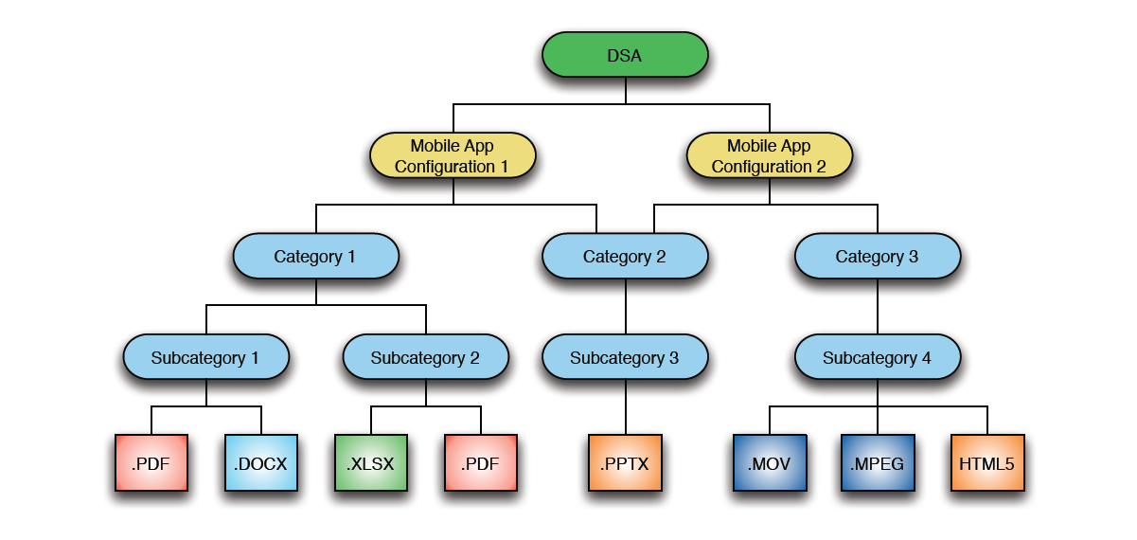
Content Hierarchy

Slide 7
Object Permissions
Category
Users must have at least read-only access to all fields
Mobile App Configuration
Users must have at least read only access to all configurations and fields
Category Mobile Configuration
Users must have at least read only access to all configurations and fields
Content Review
Users must have Write Access to this Object

Slide 8
Contacts Download
If users have access to large number of contacts, think through how you want to filter the contacts

Slide 9
Internal MM Responsibilities

Slide 10
DSA Standard Project – No Customizations
Example Projects
Carefusion, Bombardier Phase 1, Abbott Nutrition, B+L
Resources Required
PM
Role to keep the project in scope and push back
Dev
Required from day 1 to be able to compile the base DSA Code base and add the Customer App Name and App Icon
Minimal Changes to the App if there is time – Like changing the Accounts / Contacts Query.
SBA
Configure Org for the Client
Understand DSA from a Salesforce.com perspective and what needs to be done

Slide 11
DSA Standard Project – Small Customizations
Example Projects
Carestream
Client also signs a Enhancement Budget / is part of the initial Project Scope.
Resources Required
PM
Role to keep the project in scope and push back
QA the small changes so they are working
Dev
Required from Day 1 to be able to compile the base DSA Code base and add the Customer App Name and App Icon
Minimal Changes to the App if there is time – Like changing the Accounts / Contacts Query.
Understand DSA to add new capabilities like Logging a call, Changing the Report a Problem page
SBA
Configure Org for the Client
Understand DSA from a Salesforce.com perspective and what needs to be done
QA the small changes so they are working

Slide 12
DSA Standard Project – Large Customizations
Example Projects
Bombardier, Cepheid
Resources Required
TA
Understand Mobile and DSA atleast at a high level
Ability to fully grasp how the back end of DSA works as well as the iPad App
PM
Role to keep the project in scope and push back
Get history on the project ahead of time so the real reason for requirements in the next phase are clearly understood and plan scope accordingly.
Dev
Required from day 1 to be able to compile the base DSA Code base and add the Customer App Name and App Icon
Must understand iOS to add large capabilities and changing the core of DSA like Adding a Image gallery
SBA
Configure Org for the Client
Understand DSA from a Salesforce.com perspective and what needs to be done
Understand how Profiles / Roles work as they play a key part in setting all the content up
Use Cases and Scenarios for the Custom Work
QA
Must understand the basics of DSA
Start testing with the changes after 1st build.

Slide 13
Thank You

